Slide 1
MB6 - ML Model Review

Slide 2
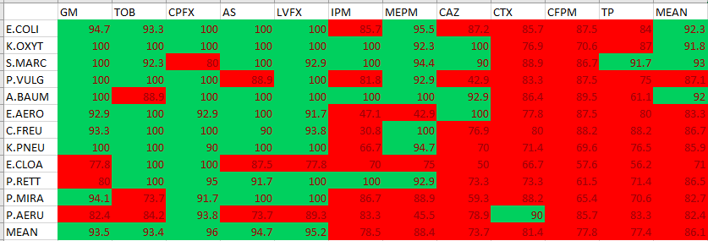
MB5 ML model: Random Forest all data points: 73,342 (train and test sets) Cycles: 9 = 4 hours
EA results on the test set 1 (18,163 data points)
The G/I prediction for some drugs (e.g., CAZ, CTX, CFPM, TP) is more challenging than some other drugs (e.g. LVFX and CPFX )

Slide 3
MB6 ML Models
Model | Description | Accuracy improvement
RF Model 32 | Without organism strain as feature | 50% of bug/drug combinations meet the 90% agreement
RF Model 46 | With organism strain as feature | Slight improvement for important bug/drug combinations
LSTM Model 50 | With organism strain as feature Across dilutions, G/I target | Slight improvement for important bug/drug combinations
LSTM Model 54 | With organism strain as feature Across dilutions, MIC target | No improvement
MB5 final model

Slide 4
LSTM Model vs Random forest
- Learning structure
LSTM : A deep learning model which can learn from the sequence of data
LSTM:
- Order of dilutions is considered
...
...
Random forest:
- Order of dilutions is not considered
dilution 1
dilution 3
dilution 5
dilution 7
dilution 1
dilution 3
dilution 5
dilution 7
dilution 2
dilution 4
dilution 6
dilution 8
dilution 2
dilution 4
dilution 6
dilution 8
Input:
Organism A/Drug X
Organism B/Drug Y

Slide 5
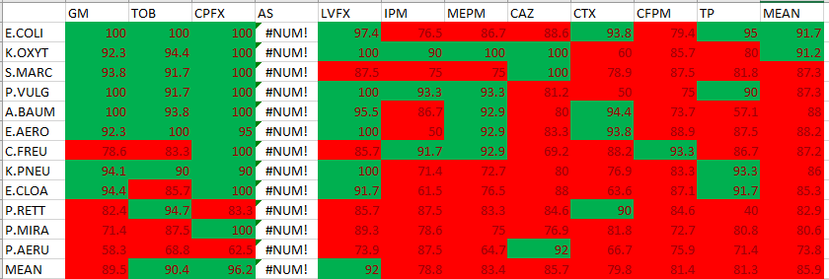
LSTM- Model 50 -target G/I- EA on test set
* All models have been trained and tested on the same train and test sets

Slide 6
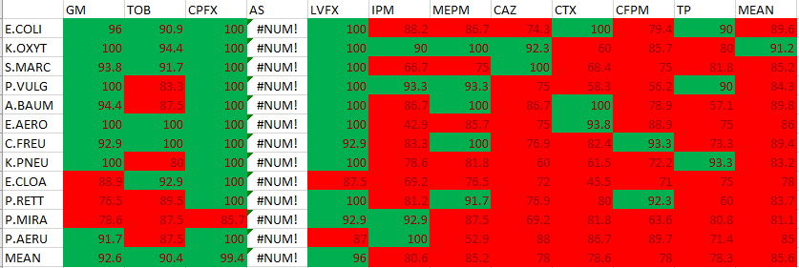
Random Forest- Model 46- EA on test set
* All models have been trained and tested on the same train and test sets

Slide 7
MB6
important combinations
 | Algorithm: | RF w/o strain Model 32 | RF w strain Model 46 | RF w strain Model 46 | LSTM w strain G/I target Model 50 | LSTM w strain MIC target Model 54
 |  | 1 | 2 | 3 | 4 | 5
 | Dataset: | Test set 1 | Test set 1 | Test set 2 | Test set 2 | Test set 2
 | Date: | 12-Dec | 26-Jan | 26-Jan | 26-Jan | 26-Jan
CAZ | E.COLI | 87.2 | 89.7 | 74.3 | 88.6 | 57.1
 | K.PNEU | 70.0 | 70.0 | 60.0 | 80.0 | 73.3
 | E.CLOA | 50.0 | 46.9 | 72.0 | 88.0 | 36
 | P.MIRA | 59.3 | 63.0 | 69.2 | 76.9 | 76.9
CFPM | E.COLI | 87.5 | 87.5 | 79.4 | 79.4 | 73.5
 | K.PNEU | 69.6 | 73.9 | 72.2 | 83.3 | 66.7
 | E.CLOA | 57.6 | 63.6 | 71.0 | 87.1 | 74.2
 | P.MIRA | 65.4 | 65.4 | 63.6 | 72.7 | 45.5
 | Average: | 68.3 | 70.0 | 70.2 | 82.0 | 62.9

Slide 8
Confidence interval for EA (Based on LSTM- model 50)

Slide 9
Create 5 models with different data splits
Split 1
Test
Train
Split 2
Train
Test
Train
Split 3
Train
Test
Train
Split 4
Train
Test
Train
Split 5
Train
Test
In each split, 1/5 of data is designated to test and the rest is designated to train + validation
Test sets are not overlapping

Slide 10
5 LSTM models
Model | Data | F1 score
Model 1 | Split 1 | 0.87
Model 2 | Split 2 | 0.89
Model 3 | Split 3 | 0.88
Model 4 | Split 4 | 0.88
Model 5 | Split 5 | 0.88

Slide 11
EA average and range with 95% confidence
 | GM | TOB | CPFX | LVFX | IPM | MEPM | CAZ | CTX | CFPM | TP
E.COLI | 97.3 (±) 2.0 | 96.2 (±) 2.7 | 96.9 (±) 5.4 | 97.0 (±) 2.2 | 83.5 (±) 6.3 | 94.5 (±) 2.8 | 92.7 (±) 3.9 | 80.9 (±) 7.4 | 82.3 (±) 6.4 | 91.5 (±) 4.5
K.OXYT | 100.0 (±) 0.0 | 93.1 (±) 5.0 | 95.7 (±) 4.7 | 98.5 (±) 2.7 | 94.8 (±) 6.3 | 100.0 (±) 0.0 | 98.6 (±) 2.5 | 78.5 (±) 10.5 | 87.3 (±) 6.6 | 91.8 (±) 6.6
S.MARC | 95.8 (±) 4.5 | 93.2 (±) 5.5 | 92.0 (±) 3.7 | 95.3 (±) 3.4 | 76.8 (±) 10.2 | 78.2 (±) 8.1 | 95.1 (±) 5.8 | 84.5 (±) 13.2 | 89.3 (±) 6.5 | 93.4 (±) 4.8
P.VULG | 96.1 (±) 4.2 | 96.6 (±) 3.8 | 98.3 (±) 2.9 | 100.0 (±) 0.0 | 86.4 (±) 6.1 | 79.1 (±) 9.8 | 75.1 (±) 9.4 | 70.5 (±) 14.1 | 70.8 (±) 15.5 | 70.0 (±) 5.6
A.BAUM | 98.3 (±) 2.9 | 97.4 (±) 2.8 | 96.3 (±) 4.2 | 97.2 (±) 3.0 | 93.1 (±) 6.4 | 89.3 (±) 10.7 | 90.1 (±) 4.8 | 87.5 (±) 7.1 | 84.0 (±) 9.6 | 51.8 (±) 11.1
E.AERO | 95.3 (±) 5.1 | 97.3 (±) 4.7 | 93.4 (±) 5.1 | 91.1 (±) 9.5 | 65.8 (±) 11.8 | 80.4 (±) 6.7 | 92.5 (±) 9.7 | 92.5 (±) 6.5 | 93.3 (±) 8.5 | 86.5 (±) 3.5
C.FREU | 94.2 (±) 6.4 | 94.0 (±) 4.4 | 92.7 (±) 8.1 | 89.3 (±) 13.6 | 74.3 (±) 11.4 | 94.3 (±) 6.9 | 75.4 (±) 8.0 | 77.4 (±) 8.7 | 81.0 (±) 16.3 | 85.7 (±) 11.0
K.PNEU | 100.0 (±) 0.0 | 98.5 (±) 2.7 | 98.2 (±) 3.2 | 94.4 (±) 3.2 | 78.6 (±) 9.8 | 87.0 (±) 10.1 | 84.5 (±) 5.5 | 76.6 (±) 13.0 | 83.2 (±) 3.6 | 82.2 (±) 8.2
E.CLOA | 93.0 (±) 6.0 | 97.2 (±) 3.1 | 98.0 (±) 3.5 | 93.4 (±) 5.5 | 72.7 (±) 10.8 | 77.0 (±) 12.8 | 75.2 (±) 6.6 | 71.8 (±) 7.0 | 82.4 (±) 5.2 | 80.5 (±) 10.8
P.RETT | 88.6 (±) 10.2 | 80.3 (±) 3.0 | 98.0 (±) 3.5 | 96.7 (±) 5.9 | 77.6 (±) 12.7 | 89.1 (±) 9.5 | 55.9 (±) 16.6 | 83.7 (±) 3.0 | 72.7 (±) 10.6 | 63.9 (±) 18.4
P.MIRA | 74.6 (±) 15.5 | 80.1 (±) 7.3 | 94.3 (±) 4.4 | 89.5 (±) 3.9 | 68.7 (±) 5.9 | 55.0 (±) 8.7 | 61.2 (±) 6.3 | 87.8 (±) 10.8 | 66.9 (±) 7.6 | 65.7 (±) 12.6
P.AERU | 68.1 (±) 7.3 | 53.0 (±) 17.0 | 56.1 (±) 13.8 | 64.4 (±) 3.4 | 80.8 (±) 4.6 | 67.3 (±) 8.1 | 73.1 (±) 6.3 | 63.2 (±) 13.7 | 76.0 (±) 4.3 | 63.5 (±) 12.5

Slide 12
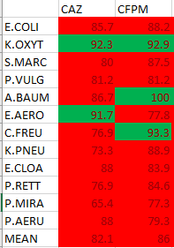
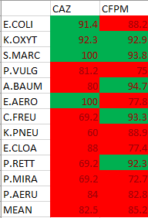
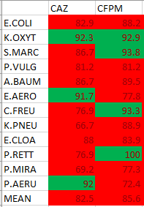
Drug specific model- CAZ, CFPM Train set : 11496(all CAZ, CFPM) Test set: 3856 (CAZ, CFPM)
Drug specific models - CAZ and CFPM only
Drug specific model – 50% of CAZ, CFPM Train set : 5608 (50% of CAZ, CFPM)
Test set: 3856 (CAZ, CFPM)
Drug specific model – 25% of CAZ, CFPM Train set : 2928 (25% of CAZ, CFPM)
Test set: 3856 (CAZ, CFPM)

Slide 13
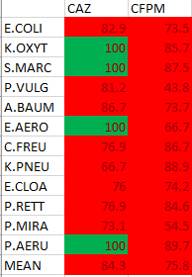
General model- Full data Train set : 46896 (all drugs)
Test set: 3856 (CAZ, CFPM)

Slide 14
Effect of data size on EA

Slide 15
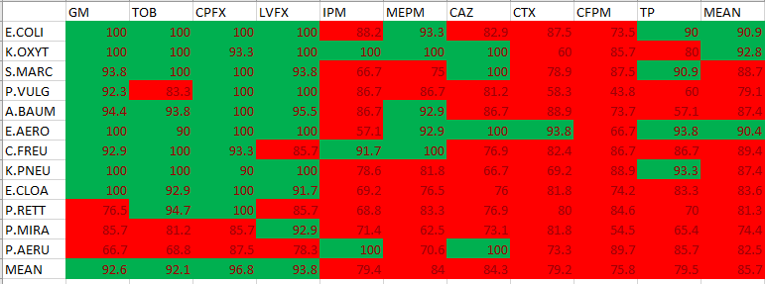
LSTM full data

Slide 16
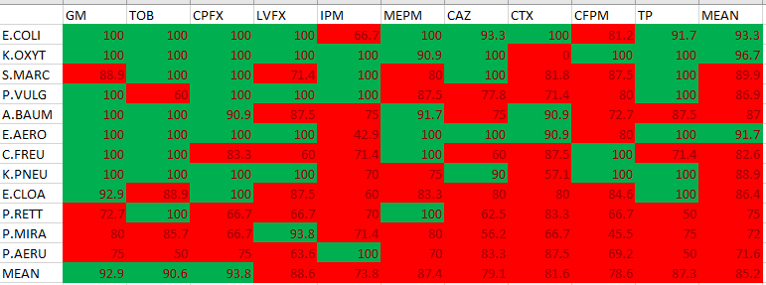
Train set = 50% reduced Test set = 50% reduced

Slide 17
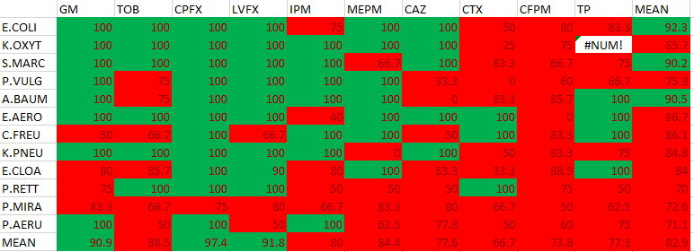
Train set = 25% reduced Test set = 25% reduced

Slide 18
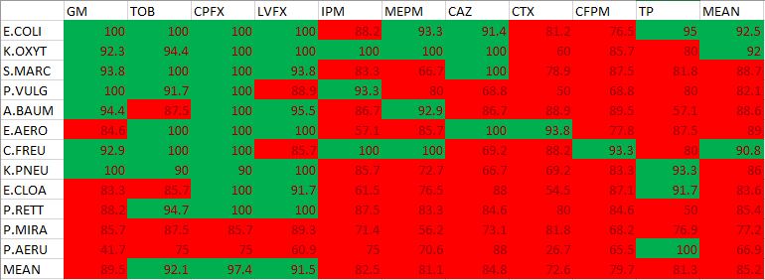
Train set = 50% reduced Test set = full test set

Slide 19
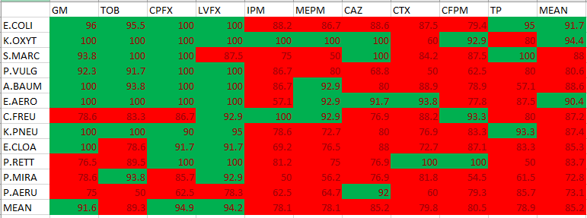
Train set = 25% reduced Test set = full test set

Slide 20
Test set in split 1
 | GM | TOB | CPFX | AS | LVFX | IPM | MEPM | ST | CAZ | CTX | CFPM | TP | SUM
E.COLI | 104 | 184 | 112 | 0 | 208 | 96 | 168 | 0 | 272 | 72 | 272 | 128 | 1616
K.OXYT | 64 | 80 | 64 | 0 | 88 | 104 | 128 | 0 | 64 | 80 | 48 | 80 | 800
S.MARC | 88 | 120 | 88 | 0 | 96 | 48 | 96 | 0 | 96 | 104 | 80 | 80 | 896
P.VULG | 96 | 88 | 128 | 0 | 80 | 104 | 72 | 0 | 104 | 80 | 56 | 88 | 896
A.BAUM | 88 | 128 | 136 | 0 | 56 | 112 | 120 | 0 | 56 | 112 | 88 | 80 | 976
E.AERO | 80 | 48 | 80 | 0 | 72 | 48 | 56 | 0 | 56 | 40 | 128 | 96 | 704
C.FREU | 88 | 72 | 72 | 0 | 80 | 96 | 120 | 0 | 96 | 80 | 72 | 112 | 888
K.PNEU | 88 | 96 | 56 | 0 | 152 | 104 | 80 | 0 | 168 | 88 | 192 | 168 | 1192
E.CLOA | 80 | 96 | 80 | 0 | 160 | 120 | 120 | 0 | 136 | 64 | 192 | 88 | 1136
P.RETT | 64 | 96 | 112 | 0 | 72 | 104 | 96 | 0 | 56 | 56 | 96 | 72 | 824
P.MIRA | 128 | 104 | 64 | 0 | 200 | 104 | 120 | 0 | 184 | 80 | 192 | 144 | 1320
P.AERU | 104 | 112 | 72 | 0 | 208 | 96 | 96 | 0 | 248 | 72 | 184 | 72 | 1264
SUM | 1072 | 1224 | 1064 | 0 | 1472 | 1136 | 1272 | 0 | 1536 | 928 | 1600 | 1208 | 12512

Slide 21
Test set in split 2
 | GM | TOB | CPFX | AS | LVFX | IPM | MEPM | ST | CAZ | CTX | CFPM | TP | SUM
E.COLI | 216 | 144 | 96 | 0 | 208 | 96 | 176 | 0 | 240 | 152 | 192 | 144 | 1664
K.OXYT | 104 | 120 | 72 | 0 | 72 | 88 | 56 | 0 | 80 | 104 | 72 | 80 | 848
S.MARC | 64 | 72 | 88 | 0 | 104 | 128 | 64 | 0 | 72 | 72 | 104 | 80 | 848
P.VULG | 72 | 40 | 56 | 0 | 88 | 104 | 80 | 0 | 136 | 32 | 104 | 96 | 808
A.BAUM | 144 | 120 | 104 | 0 | 112 | 88 | 80 | 0 | 200 | 136 | 152 | 80 | 1216
E.AERO | 120 | 56 | 72 | 0 | 72 | 64 | 112 | 0 | 88 | 80 | 32 | 80 | 776
C.FREU | 128 | 88 | 80 | 0 | 80 | 32 | 96 | 0 | 104 | 80 | 80 | 88 | 856
K.PNEU | 72 | 112 | 80 | 0 | 152 | 72 | 56 | 0 | 200 | 64 | 200 | 120 | 1128
E.CLOA | 72 | 80 | 104 | 0 | 168 | 40 | 128 | 0 | 208 | 48 | 160 | 96 | 1104
P.RETT | 120 | 80 | 112 | 0 | 72 | 64 | 88 | 0 | 96 | 112 | 104 | 32 | 880
P.MIRA | 64 | 128 | 80 | 0 | 144 | 88 | 112 | 0 | 168 | 56 | 120 | 120 | 1080
P.AERU | 80 | 96 | 112 | 0 | 184 | 88 | 128 | 0 | 216 | 72 | 200 | 120 | 1296
SUM | 1256 | 1136 | 1056 | 0 | 1456 | 952 | 1176 | 0 | 1808 | 1008 | 1520 | 1136 | 12504

Slide 22
Test set in split 3
 | GM | TOB | CPFX | AS | LVFX | IPM | MEPM | ST | CAZ | CTX | CFPM | TP | SUM
E.COLI | 168 | 232 | 128 | 0 | 176 | 192 | 184 | 0 | 256 | 104 | 216 | 176 | 1832
K.OXYT | 88 | 88 | 72 | 0 | 104 | 40 | 48 | 0 | 64 | 96 | 136 | 80 | 816
S.MARC | 56 | 48 | 88 | 0 | 104 | 80 | 120 | 0 | 104 | 104 | 88 | 56 | 848
P.VULG | 88 | 80 | 80 | 0 | 72 | 96 | 96 | 0 | 64 | 72 | 72 | 112 | 832
A.BAUM | 104 | 144 | 104 | 0 | 112 | 136 | 48 | 0 | 120 | 96 | 104 | 112 | 1080
E.AERO | 72 | 120 | 112 | 0 | 88 | 136 | 96 | 0 | 40 | 48 | 96 | 104 | 912
C.FREU | 112 | 88 | 72 | 0 | 32 | 104 | 64 | 0 | 72 | 64 | 32 | 72 | 712
K.PNEU | 120 | 96 | 96 | 0 | 184 | 64 | 56 | 0 | 216 | 56 | 128 | 24 | 1040
E.CLOA | 88 | 88 | 64 | 0 | 176 | 120 | 144 | 0 | 168 | 104 | 144 | 152 | 1248
P.RETT | 104 | 112 | 80 | 0 | 88 | 104 | 56 | 0 | 136 | 56 | 88 | 40 | 864
P.MIRA | 104 | 120 | 136 | 0 | 192 | 80 | 80 | 0 | 144 | 120 | 192 | 96 | 1264
P.AERU | 136 | 120 | 64 | 0 | 128 | 72 | 40 | 0 | 136 | 80 | 192 | 88 | 1056
SUM | 1240 | 1336 | 1096 | 0 | 1456 | 1224 | 1032 | 0 | 1520 | 1000 | 1488 | 1112 | 12504

Slide 23
Test set in split 4
 | GM | TOB | CPFX | AS | LVFX | IPM | MEPM | ST | CAZ | CTX | CFPM | TP | SUM
E.COLI | 136 | 152 | 104 | 0 | 280 | 128 | 136 | 0 | 136 | 112 | 200 | 232 | 1616
K.OXYT | 64 | 72 | 88 | 0 | 88 | 72 | 96 | 0 | 112 | 48 | 88 | 104 | 832
S.MARC | 80 | 96 | 64 | 0 | 80 | 80 | 80 | 0 | 96 | 80 | 104 | 152 | 912
P.VULG | 80 | 112 | 96 | 0 | 96 | 72 | 56 | 0 | 80 | 88 | 64 | 48 | 792
A.BAUM | 96 | 104 | 128 | 0 | 128 | 80 | 104 | 0 | 112 | 136 | 72 | 144 | 1104
E.AERO | 80 | 88 | 32 | 0 | 104 | 96 | 56 | 0 | 112 | 160 | 80 | 72 | 880
C.FREU | 64 | 80 | 104 | 0 | 120 | 64 | 64 | 0 | 96 | 120 | 128 | 56 | 896
K.PNEU | 112 | 64 | 72 | 0 | 256 | 88 | 152 | 0 | 216 | 96 | 144 | 104 | 1304
E.CLOA | 128 | 136 | 104 | 0 | 184 | 40 | 40 | 0 | 184 | 56 | 160 | 112 | 1144
P.RETT | 88 | 104 | 48 | 0 | 48 | 56 | 64 | 0 | 64 | 104 | 64 | 104 | 744
P.MIRA | 104 | 96 | 88 | 0 | 152 | 104 | 120 | 0 | 208 | 80 | 184 | 88 | 1224
P.AERU | 136 | 112 | 72 | 0 | 128 | 64 | 96 | 0 | 120 | 120 | 120 | 88 | 1056
SUM | 1168 | 1216 | 1000 | 0 | 1664 | 944 | 1064 | 0 | 1536 | 1200 | 1408 | 1304 | 12504

Slide 24
Test set in split 5
 | GM | TOB | CPFX | AS | LVFX | IPM | MEPM | ST | CAZ | CTX | CFPM | TP | SUM
E.COLI | 200 | 128 | 128 | 0 | 264 | 56 | 136 | 0 | 256 | 96 | 288 | 160 | 1712
K.OXYT | 112 | 72 | 104 | 0 | 64 | 96 | 64 | 0 | 88 | 80 | 72 | 72 | 824
S.MARC | 144 | 88 | 88 | 0 | 40 | 80 | 64 | 0 | 72 | 64 | 56 | 64 | 760
P.VULG | 96 | 112 | 72 | 0 | 88 | 72 | 112 | 0 | 64 | 120 | 104 | 88 | 928
A.BAUM | 96 | 88 | 128 | 0 | 136 | 176 | 152 | 0 | 72 | 96 | 152 | 120 | 1216
E.AERO | 64 | 96 | 104 | 0 | 80 | 48 | 80 | 0 | 104 | 104 | 56 | 64 | 800
C.FREU | 48 | 96 | 112 | 0 | 112 | 120 | 40 | 0 | 72 | 104 | 120 | 104 | 928
K.PNEU | 48 | 88 | 48 | 0 | 88 | 56 | 144 | 0 | 112 | 56 | 168 | 96 | 904
E.CLOA | 152 | 136 | 80 | 0 | 144 | 104 | 104 | 0 | 176 | 144 | 160 | 80 | 1280
P.RETT | 48 | 48 | 56 | 0 | 120 | 104 | 112 | 0 | 72 | 104 | 80 | 144 | 888
P.MIRA | 120 | 128 | 72 | 0 | 200 | 112 | 112 | 0 | 152 | 48 | 144 | 112 | 1200
P.AERU | 112 | 104 | 72 | 0 | 136 | 56 | 96 | 0 | 160 | 104 | 136 | 88 | 1064
SUM | 1240 | 1184 | 1064 | 0 | 1472 | 1080 | 1216 | 0 | 1400 | 1120 | 1536 | 1192 | 12504

Slide 25
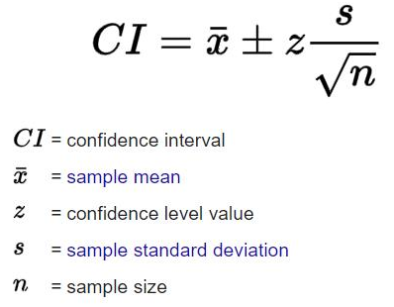
Confidence Interval (CI)
Desired Confidence Interval | Z
90% 95% 99% | 1.645 1.96 2.576

